Slide 1
Responsible AI Expansion
Trenton Chramosta
Cybersecurity Engineer @NebMed
Adjunct Faculty @UNK

Slide 2
What does it mean to be Responsible?

Slide 3
Introduction to GRC
Governance – Set of rules/policies/frameworks that defines responsibilities
Risk- finding “holes” and fixing them
Compliance- following rules/laws/regulations

Slide 4
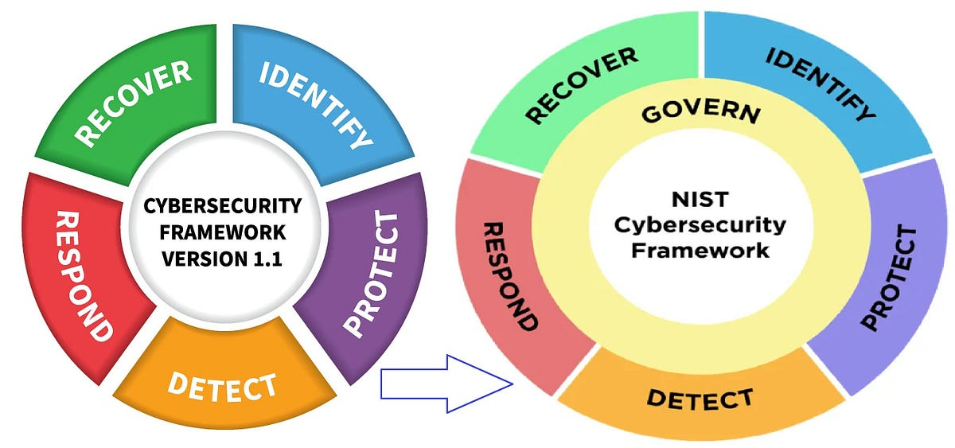
NIST 2.0 (Feb 26th, 2024)
https://nvlpubs.nist.gov/nistpubs/CSWP/NIST.CSWP.29.pdf
https://www.nist.gov/blogs/cybersecurity-insights/travel-update-nist-csf-20-herealong-many-helpful-resources

Slide 5
NIST AI RMF 1.0 (Jan 2023)
https://www.nist.gov/itl/ai-risk-management-framework
https://nvlpubs.nist.gov/nistpubs/ai/NIST.AI.100-1.pdf

Slide 6
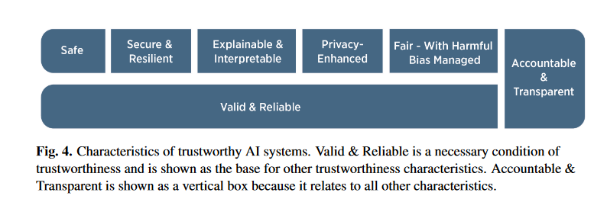
NIST AI RMF 1.0 Section 3

Slide 7
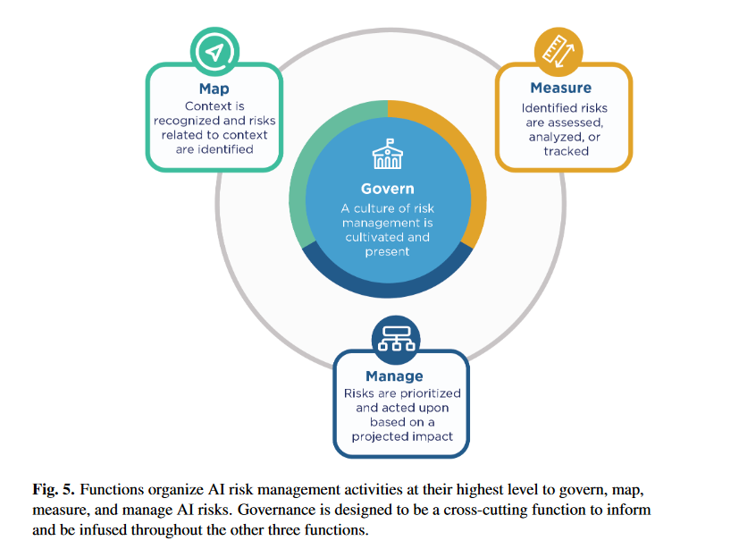
NIST AI RMF 1.0 Section 4

Slide 8
Section Transition

Slide 9
1 Text box
Hi Gang!

Slide 10
2 Text boxes
Hello
World

